Slide 1
Tourism AI Assistant for Gilgit-Baltistan
Presented By: Ashfaq Ahmad and Rukhsana Ayub Course: AI and Data Science Capstone Project

Slide 2
Introduction
About Gilgit-Baltistan: Gilgit-Baltistan is an area known for its picturesque landscapes, adventure tourism, rich cultural heritage, and historic sites.
Problem Statement: Tourists face challenges in discovering destinations, booking services, and navigating the region due to limited digital resources and fragmented tourism services.
Project Vision: To develop an AI-powered digital assistant that enhances the tourism experience by providing personalized recommendations, itinerary planning, and real-time updates.

Slide 3
Key Features of the Tourism AI Assistant
Natural Language Processing (NLP):
Tourists can interact with the system using simple, conversational language to ask questions about destinations, bookings, and weather.
AI can understand multiple languages for a diverse audience.
Voice Assistant for Navigation:
Provides voice-based guidance for navigation to attractions, nearby hotels, or restaurants, making it user-friendly for non-tech-savvy tourists.
Multilingual Support:
Supports multiple languages for both local and international tourists, allowing seamless communication and access to information.
Real-Time Updates:
Sends alerts about weather conditions, emergency services, or any changes in tourist-related events and bookings.
Data Analytics for Local Authorities:
Collects insights on tourist behavior, popular destinations, and real-time data, helping authorities make data-driven decisions on infrastructure, promotions, and sustainability efforts.

Slide 4
Motivation Behind the Project
Improving Tourist Experience: A seamless, AI-driven platform enhances the overall experience by providing personalized, up-to-date information.
Support for Local Businesses: The platform helps local vendors (hotels, tour guides, restaurants) reach a global audience and participate in the growing digital economy.
Promoting Sustainable Tourism: AI analytics will help in monitoring tourist footfall, allowing for better management of natural resources and tourism infrastructure.
Economic Empowerment: Provides employment and training opportunities in the tech sector for local youth, bridging the digital divide.

Slide 5
Technology Stack
Artificial Intelligence (AI): For personalized recommendations and predictive analytics to enhance the user experience.
Natural Language Processing (NLP): To facilitate natural and seamless communication between users and the assistant.
Cloud Computing (e.g., MS Azure): For data storage, scalability, and real-time processing of user data.
Machine Learning: To analyze tourist behavior and improve the assistant’s accuracy over time.

Slide 6
Implementation Plan
Phase 1: Research & Data Collection
Gather data on popular tourist attractions, hotels, guides, and user preferences.
Phase 2: Platform Development
Build the AI assistant using NLP and machine learning algorithms.
Phase 3: User Testing
Conduct testing with a small group of tourists to refine features and improve accuracy.
Phase 4: Launch & Marketing
Roll out the platform and promote it to local businesses and international tourists.

Slide 7
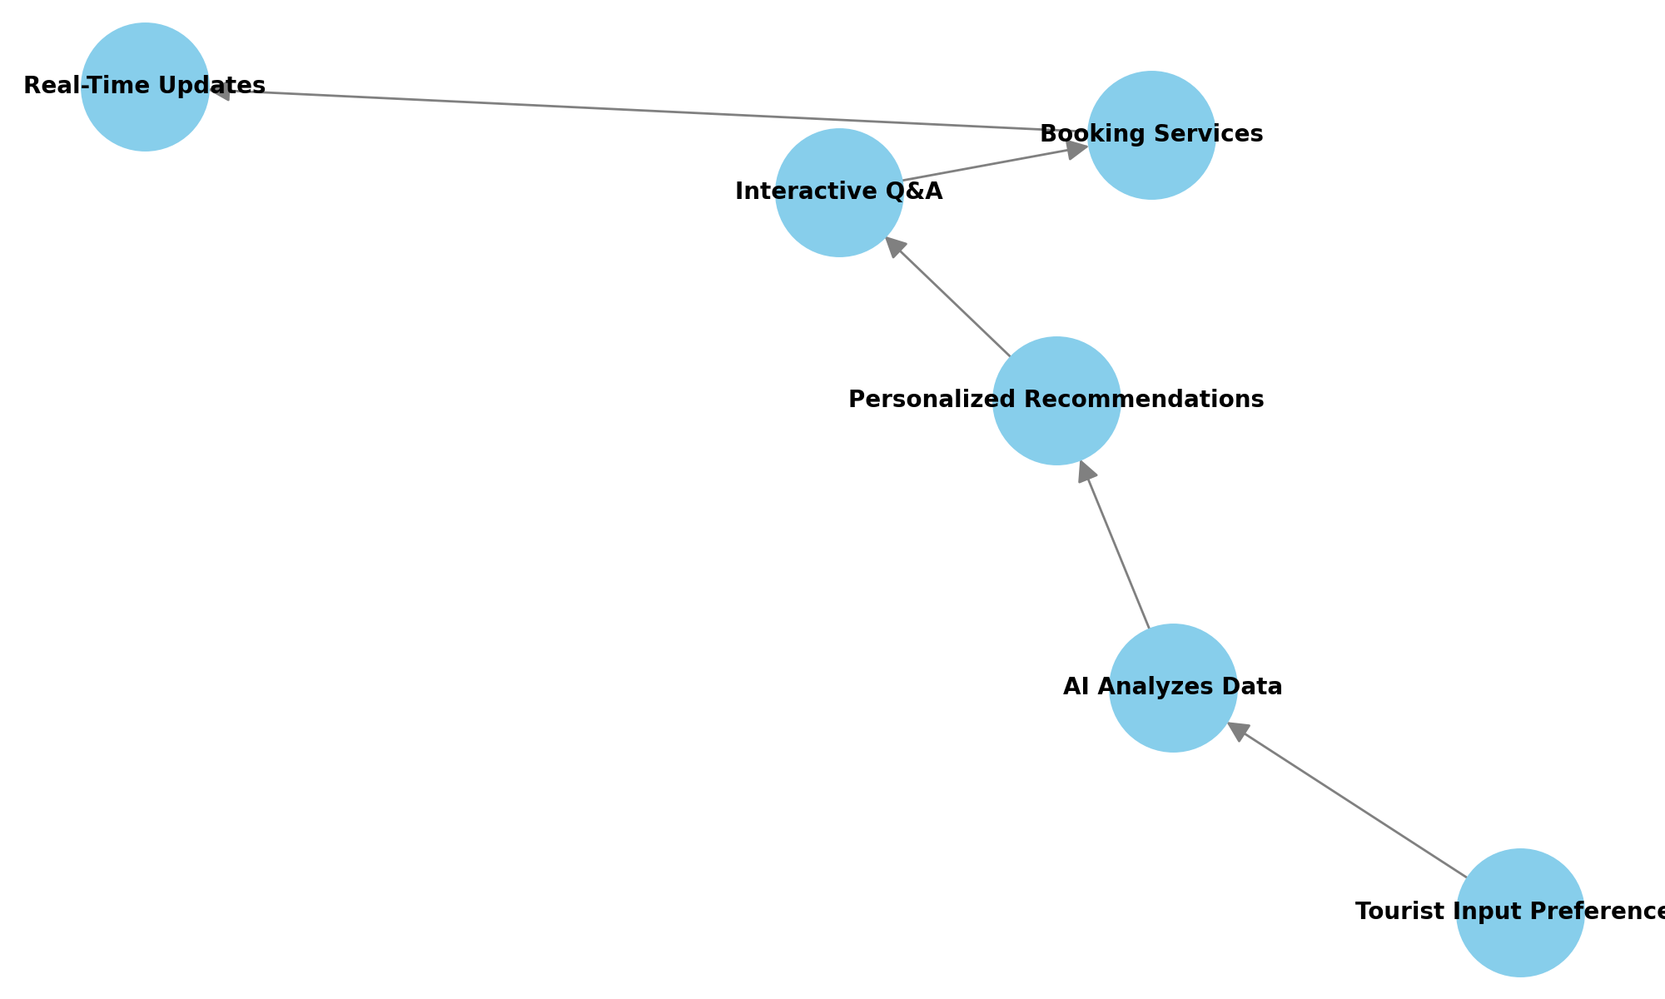
Flow Chart

Slide 8
Expected Outcomes
Improved Tourist Satisfaction: Tourists receive personalized, relevant recommendations that match their interests and preferences.
Economic Growth for Local Businesses: Local accommodations, tour operators, and shops gain visibility and attract more customers.
Sustainable Tourism Development: With AI insights, tourism can be managed to minimize environmental and cultural impact.

Slide 9
Conclusion
The Tourism AI Assistant for Gilgit-Baltistan will empower tourists, improve service accessibility, and create digital transformation in the region’s tourism industry.
By leveraging the power of AI and machine learning, the platform will foster sustainable, personalized, and inclusive tourism experiences.

